Slide 1
DOCTOR APPOINTMENT SYSTEM
BY SWARAJ PANDEY

Slide 2

Importance of project
This project is very useful these days as technology is expanding day by day
In this medical field this project will help patients to easily book an appointment with his doctor by not even stepping out from their homes.

Slide 3
About This Project
My project will enable every single patient to book an appointment with the doctor
In these covid days it will be safe that every patient reach on given time so that there could be less hustle and doctors could treat peacefully
I have used various features of c++ in this like filestream and string etc…

Slide 4
Abstract of this project
The purpose of Doctor Appointment System is to automate the existing manual system by the help of computerized equipments and full-fledged computer software, fulfilling their requirements, so that their valuable data/information can be stored for a longer period with easy accessing and manipulation of the same. The required software and hardware are easily available and easy to work with.
Doctor Appointment System, as described above, can lead to error free, secure, reliable and fast management system.

Slide 5
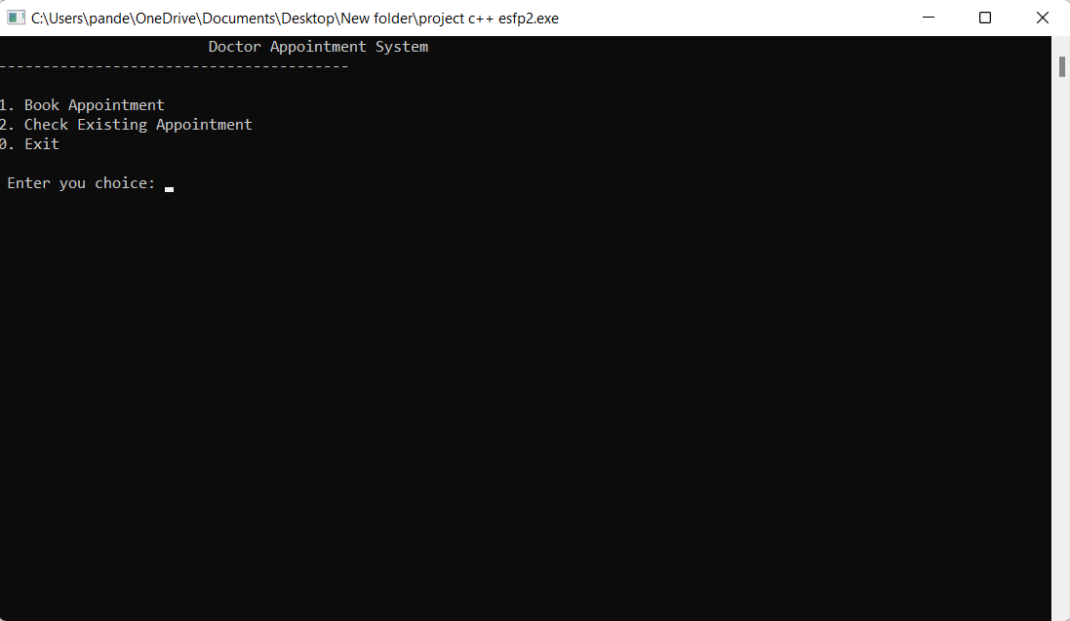
How does it looks like ?

Slide 6
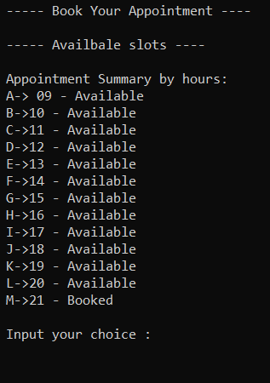
In previous slide if we press 1 then?
If we choose 1 it will show us the available slots and booked slots information and from choosing letters from A –M we can book an appointment

Slide 7
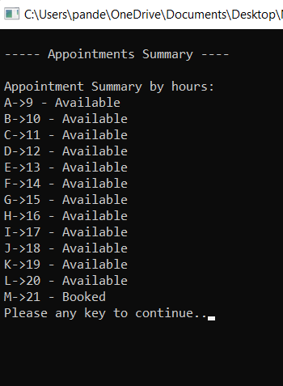
If we press 2 then ?
If we press 2 then all appointments summary would be seen .

Slide 8
THANK YOU

